Slide 1
Learning SQL
The basics

Slide 2
SQL
SQL is Structured Query Language:
A very common language to manage and manipulate data in Relational Databases.
Invented at IBM by Donald Chamberlin and Raymond Boyce
ANSI standard in 1986
Meant to be easily learned by non-programmers
Used mostly by programmers and DBA’s
Now being used with newer scalable databases also (Google Spanner)

Slide 3
Relational Database
Tables made of identical rows
Each row of a table has named columns of typed data
char(n) – fixed length strings
Varchar(n) – variable length strings of max length n
Text – 2GB text data
Bit, tinyint smallint, int, bigint
Decimal(p,s) p – digits, s = sign digits
Datetime
Many others

Slide 4
Primary Keys
Every column can (and should) contain a Primary Key (PK)
The primary key must be unique – no 2 rows of a table can have the same primary key
Common primary keys are integer, GUIDs, or unique strings
Each column can only have a single PK

Slide 5
Foreign Keys (FK)
Foreign keys relate data in one table to another table
This relationship is why this is called a relational database
Columns in Table A that are foreign keys point to a Primary Key in table B.
E.g. Policy Table - column CustomerID is a foreign key to the Customer Table (column ID or column CustomerID – the names do not have to match)
The FKs will help you create queries to get the data you want

Slide 6
CRUD
Create INSERT
Read SELECT
Update UPDATE
Delete DELETE

Slide 7
Select – Get the data you want
SELECT {columns or calculation} FROM {table(s)} WHERE {conditions}
Select LastName, FirstName FROM Customers WHERE isactive=1 ORDER BY {col1}{asc|desc}, [{col2}],…
{columns} – any column name
{calculation} – Count(), Max(), Min(), Avg(), Sum()
{conditions} – a comma separated list of conditions
Can use any column or calculation, including those not found in the SELECT columns (but must be in the tables)
Use [Like ‘%mystring%’] to match any string containing mystring
% matches any 0-n characters
_ matches a single character

Slide 8
Implicit Joins – link 2 or more tables
You can create an implicit join by having multiple tables in the FROM section, separated by commas. This is not recommended because you need to be careful of the WHERE clause, and might inadvertently get the wrong results. This is usually an inner join.
Select [Customer].[LastName], [Customer].[FirstName] FROM Customers, Policies WHERE [Customer].[CustomerID]=[Policies].[CustomerID] and [Policy].Count(*) > 3;

Slide 9
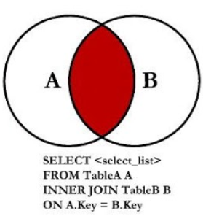
Inner Joins – Data is in both tables
An inner join returns only data where the keys exist in both the tables of the join. This usually uses foreign key of one table, and a primary key of another, along with any conditions and calculations

Slide 10
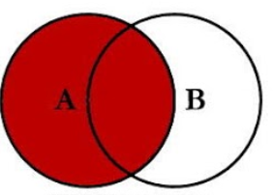
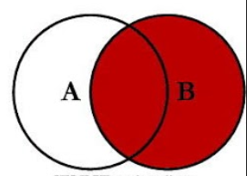
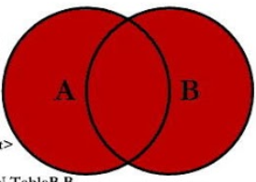
Outer Joins – All the data in one table, and matches in the other
Left outer join – all the data in the left table, matches in right
Right outer join – all the data in the right table, matches in the left
Full outer join – all the data in both tables
The number of rows returned depends on how the data is related.
1:1 – you will get the number of rows in the outer table (or biggest table for full)
1:many – you will get up to n * m rows, where n = table A rows, m = table B rows. Less depending on how the data is configured.

Slide 11
Cross Join
The Cross join multiplies every column in table A with every column in table B. Only use this if this is what you want.
Select c.LastName, p.Description from Customers cross join Policies
You get every customer with every policy even if that is not the policy belonging to the customer.
This is what you get with an implicit join without a where clause linking the foreign and primary keys of the different tables.

Slide 12
Group By
This allows you to aggregate the results. This is most useful for the mathematical and statistical calculations
How many sales in each state?
Select sum([Policies].[commission]), [location].[State] from [Policies] Inner Join [Customer] on [Policies].[CustomerID]=[Customer].[CustomerID] inner join [Location] on [Customer].[LocationID] = [Location].[LocationID]

Slide 13
Having – aggregate functions in a group by
Sometime you need to use aggregate functions (Sum, avg) while using a group by.
Which sales reps have more than $1000 in sales this month?
Group by sales rep
Need to aggregate total sales
Select pr.LastName, pr.FirstName, p.ProducerID, sum(p.Commission) from [Policies] p inner join [Producer] pr on pr.ProducerID = p.ProducerID GROUP BY p.ProducerID, pr.LastName, pr.FirstName having sum(p.Commission) > 1000

Slide 14
INSERT – Add new rows (with unique key)
INSERT into {Table} (col1,col2,..) values (val1,val2,..)
This will fail if the table has a unique primary key that is identical to the key you are trying to add
Insert into [Customer](CustomerID, LastName, FirstName, LocationID) values(1,'Doo','Scooby',2);

Slide 15
Update – alter existing data
UPDATE {table} SET col1=val1, col2=val2 WHERE {condition}
You can update all rows without a condition
If you want to update a single row, use a PK condition
Update Customer set LastName=‘Jones’ where CustomerID=4
You can change multiple rows with the appropriate condition
Update Policies set Description = ‘Homeowners Insurance’ where Description = “Homeowners’
This will fail if the row doesn’t exist

Slide 16
What are relational databases good for?
Complex queries and reports.
Situations where the data format is well known and unlikely to change
Transactions – Business rules where certain conditions need to occur before a process/sale is allowed, and several thing must occur together
i.e. Bill the customer for the sale, and ship the product
Relations between things are known in advance

Slide 17
What are relational databases not good for?
Storing / caching code objects
Storing information of unknown (in advance) types, or unrelated information
Storing Denormalized data or quick access
Large amounts of information that needs to scale across multiple servers (Google search, mapping, large numbers of simultaneous users)

